Slide 1

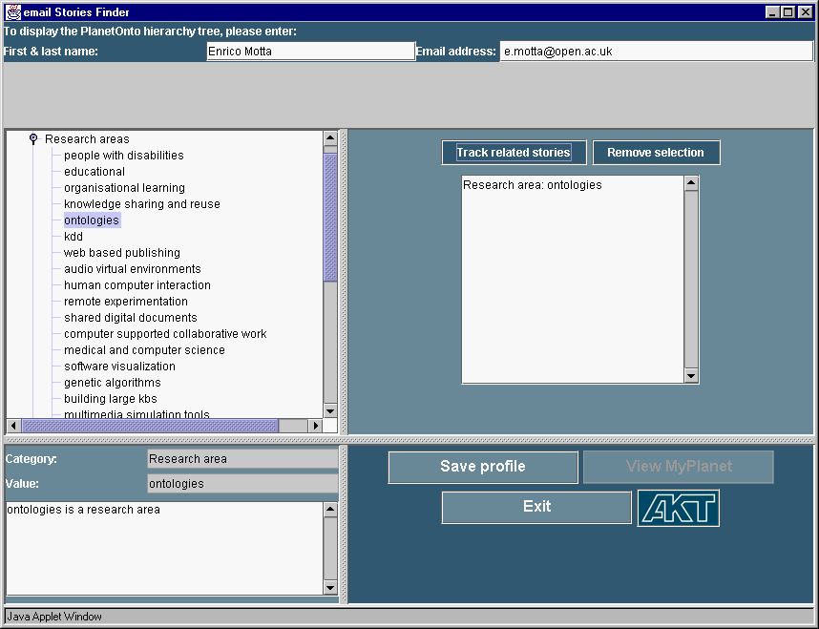
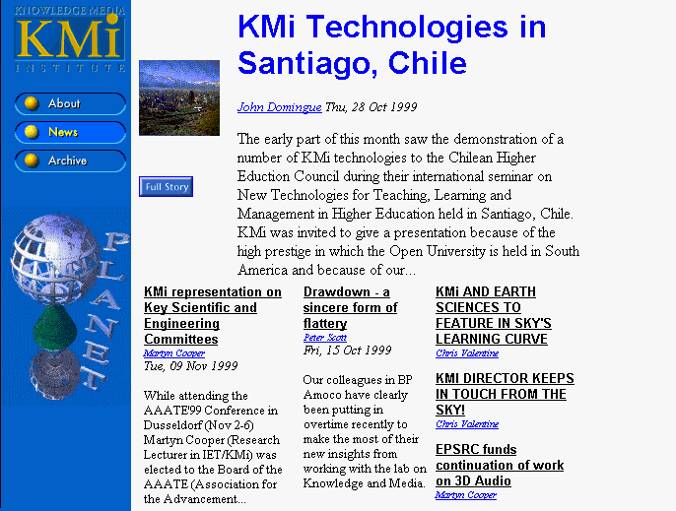
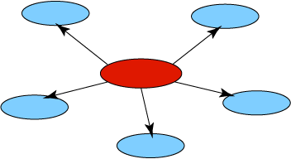
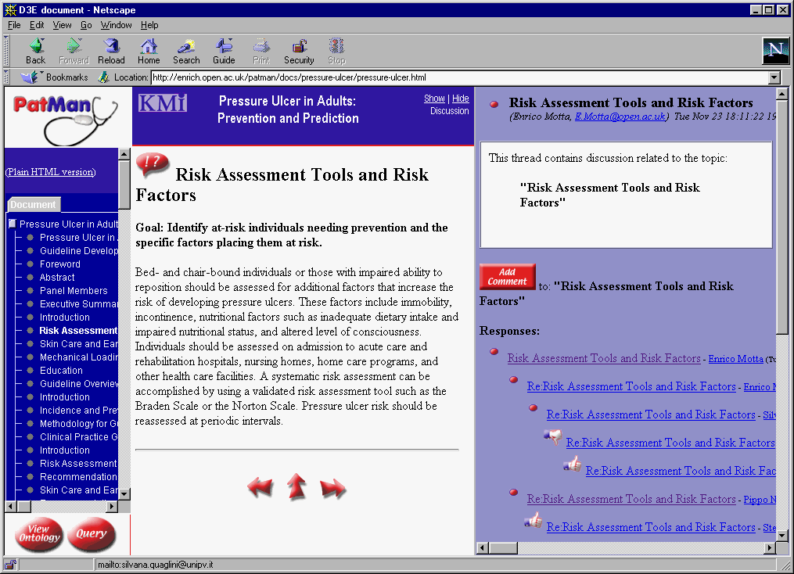
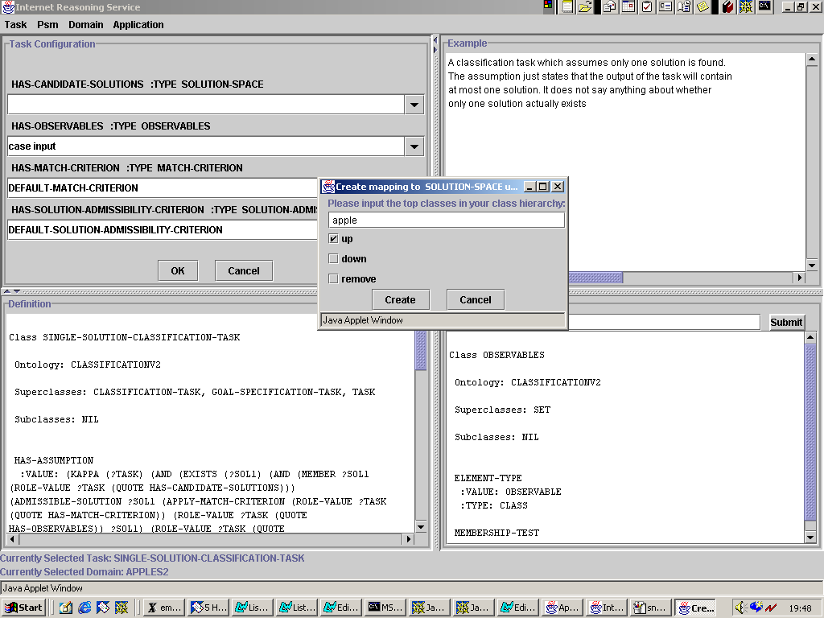
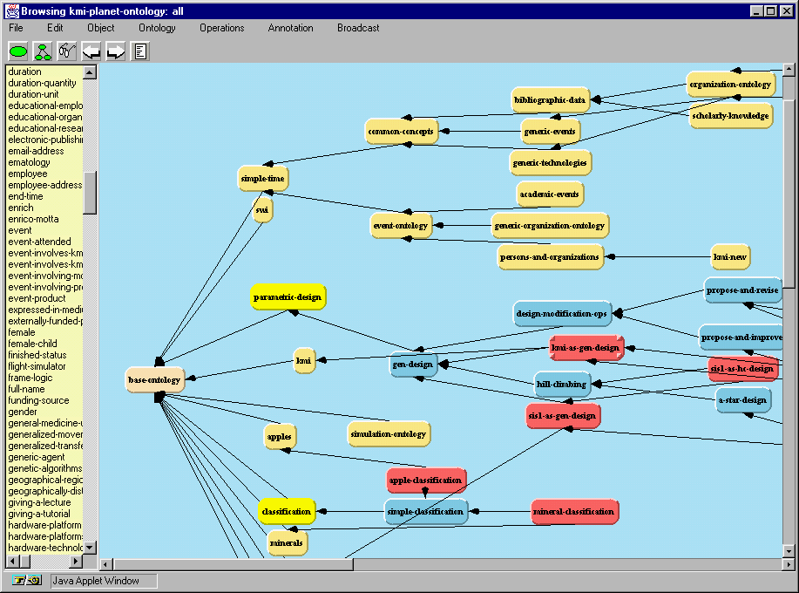
Semantic Web - the Key Concern of AI and W3C Communities
Based on tutorials and presentations:
D. Fensel, P. Constantopoulos, J. Busch, A. Sheth, J. Chen-Burger, E. Motta, B. Matthews, S. Robinson, E. Kim, T. Berners-Lee, E. Prudhommeaus, L. Ding, J. Hendler, O. Lassila, V. C. Sekhar, C. Goble

Slide 2

Managing and Integrating Web Resources with the Help of Semantic Web - are among the basic abilities of an Intelligent Agent

Slide 3


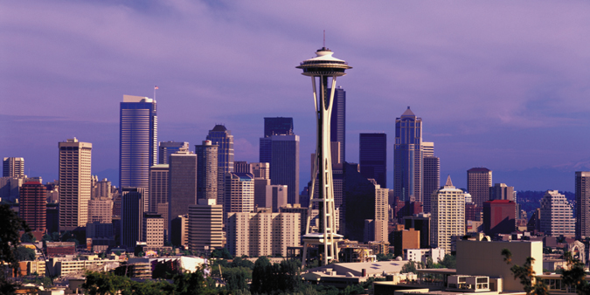
A Few AI Highlights from
IJCAI 2001, Seattle, USA

Slide 4
IJCAI-01 Tutorials
Knowledge Management
Agent Communication and Systems
Knowledge Mark-Up
Machine Learning from Text
Questions and Answering
Search algorithms, empirical methods, Lisp, NN, OR and CSP, Computer Games

Slide 5
Highlights (IJCAI-01)
Knowledge Management
Agent Communication for Knowledge Based E-Market
Information Extraction
The Hal 9000 Computer and the Vision of 2001: A Space odyssey - by David G Stork
RoboCup

Slide 6
Knowledge Management Process
Stefan Decker and Steffen Staab (IJCAI-01)
Knowledge Goals
  Knowledge Identification
  Knowledge Capturing
  Knowledge Structuring
  Knowledge Dissemination
  Knowledge Usage
  Knowledge Preservation
Knowledge Assessment

Slide 7
AI Techniques used for Knowledge Management (IJCAI-01)
Knowledge Discovery
Ontology-based KM
MetaData-based KM
Information Retrieval
Case Based Reasoning
Topic Maps
Visualisation Techniques
...

Slide 8
Agent Communication for Knowledge Based E-Market
Benjamin Grosof and Yannis Labrou (IJCAI-01)
Intelligent Agents in Web E-Commerce
  Sales agents
  Buyer agents
Billions/Trillions of agents
  automatically perform knowledge gathering, reasoning, economic optimisation and bidding.
The world is XML
  structured detailed descriptions
  Open standards

Slide 9
Agent Communication and Semantic Web (IJCAI-01)
Agent Communication using a common language over the Web-wide scale
Revolution of Internet:
  1st generation: Internet
  2nd generation: World Wide Web
  3rd generation: Semantic Web
"The Semantic Web approach proposes Languages for expressing info and relationships between info over time, they will accommodate formal system techniques for verification, inconsistency checking and reasoning." - W3C

Slide 10
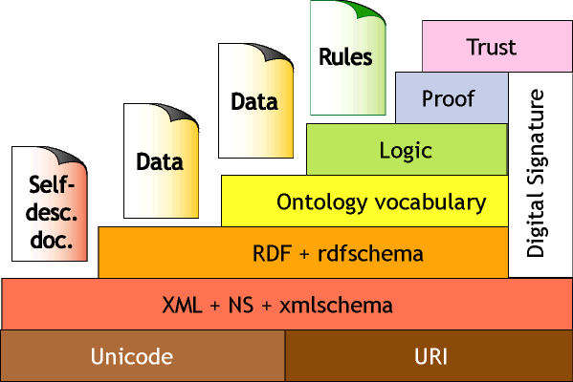
Tim Berners-Lee's Vision of Semantic Web (IJCAI-01)

Slide 11

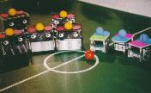
RoboCup (IJCAI-01)
Soccer Simulation
Small-sized Robot
Medium-sized Robot
Sony Legged Robot League

Slide 12
The World Wide Web Consortium (W3C)
1989: Web designed and built at CERN by Tim Berners Lee
W3C formed in 1994 (Chair Tim Berners Lee)
to lead the Web to its full potential as a forum for information, commerce, communication, and collective understanding
by developing common protocols that promote its evolution and ensure its interoperability

Slide 13
Current W3C Trends
Current trends on Web development leading to a more sophisticated architecture
  Semantic Web
  Device independence
  Web Services
Transmission and use of trust integral to this architecture
Also specific trust technologies in support role

Slide 14
Trend 1
Data rather than Documents (XML)
      last three-four years
MetaData (Data about Data)
  (XML/RDF)
  Current Cutting Edge
Cross Sector Linkage
  (RDF, Inference)
  Research projects
Reasoning (RDF)
W3C research (DAML)
Data web
Semantic Web
Web of Trust

Slide 15
RDF & RDFS
Provide a data model and syntax convention for representing the semantics of data in standardized way
Describe relationships among resources as “subject-verb-object” triples and properties & values
RDFS – Minimal ontology modeling language, object oriented type system

Slide 16
Ontology Layer
A common agreed vocabulary to describe a subject domain

Slide 17
DAML + OIL, OWL
Language(s) for the Semantic Web
Build on top of RDF and XML
Adds more constraints to RDF
Allows definition, sharing, composition and use of ontologies
Frame based knowledge representation language
Add meta-data about anything which has URI

Slide 18
Current Trend 2
Device independence and modularization
Different devices will use different subsets of HTML tags;
Define Modules
  XHTML is being designed as a series of modules associated with different functionality: text, tables, forms, images etc.
  In the future, Cascading Style Sheets (CSS) and Synchronized Multimedia Integration Language (SMIL) specifications will have the same modular construction.
Different versions of content can be generated for different devices, for example using only the text modules, or perhaps using full graphics with scripting.
Thus in its document profile (in RDF), the document specifies the expected capabilities of the browser in terms of XHTML support, style sheet support and so on.

Slide 19
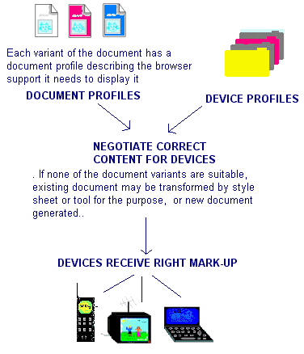
Trends 1, and 2
Device Independence, Modularisation and Inference
During the process of matching, the document profile would be compared with the device profile, the best fit between the two would be discovered, and a suitable document would be generated or the best fitting variant would be selected

Slide 20
Trend 3
Support for distributed Web Services
  XML Protocol
  The goal of the XML Protocol Activity is to develop technologies which allow two or more peers to communicate in a distributed environment, using XML as its encapsulation language
  Solutions developed by this activity allow a layered architecture on top of an extensible and simple messaging format, which provides robustness, simplicity, reusability and interoperability.

Slide 21
Support Technologies
Also specific trust technologies in support role
  P3P
  XML Signature
  XML Encryption

Slide 22
Privacy
Concerns about privacy of personal data on the Web
Platform for Privacy Preferences (P3P)
  candidate recommendation (December 2000).
Allows:
  Web service providers to make a formal statement of their privacy policies.
  Users to set their privacy preferences
  manual or automatic comparison of preferences against policy.

Slide 23
Digital Signatures
XML Signature
  Candidate Recommendation (October 2000)
  Joint work with IETF
Develop a XML syntax used for representing signatures on digital content and procedures for computing and verifying such signatures.
Requires Canonical XML

Slide 24
XML Encryption
Developing a process for encrypting/decrypting digital content (including XML documents and portions thereof)
an XML syntax used to represent the
  (1) encrypted content and
  (2) information that enables an intended recipient to decrypt it.
Still at the draft stage

Slide 25
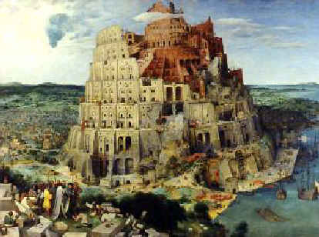
Why Semantic Web
The Book of Genesis tells of a great tower built by men not only from fear of a second Flood but above all “to make a name for themselves”. Gods’ punishment was the Babylonian confusion of tongues, with men unable to understand each other, the result being that the tower was never finished.

Slide 26
The Message in a Nutshell
The computer was invented as a device for computation.
Then the PC was detected as a means for games, text processing and power point presentations.
Meanwhile the “computer” becomes a portal to cyberspace.
The “computer” is in fact an entry point to a world-wide network of information exchange and business transactions.
Technology that supports access to unstructured, heterogeneous and distributed information and knowledge sources will become as essential as programming languages were in the 60’s and 70’s.
The semantic web is one if not the major key technology for this development.

Slide 27
The Vision: A Brain for Humanity
The World Wide Web is a big and impressive success story, both in terms
  of the amount of available information and
  of the growth rate of human users.
It starts to penetrate most areas of our daily life and business.
This success is based on its simplicity.
  The restrictiveness of HTTP and (early) HTML allowed software developers, information provider, and users to make easy access of to new media helping it to reach a critical mass.

Slide 28
The Vision: A Brain for Humanity
However, this simplicity may hamper the further development of the Web.
Or in other words: What we see currently is the very first version of the web and the next version will probably even more bigger and much more powerful compared to what we have now.

Slide 29
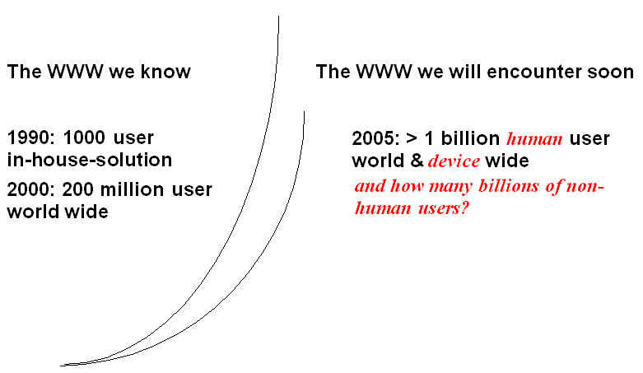
The Vision: A Brain for Humanity

Slide 30
The Vision: A Brain for Humanity
Tim Berners-Lee has a vision of a semantic web which
has machine-understandable semantics of information, and
trillions of small specialized reasoning services that provide support in automated task achievement based on the accessible information.
=> This gives a completely new perspective for the knowledge acquisition, knowledge engineering, and knowledge representation communities.

Slide 31
The Vision: A Brain for Humanity
Twenty years ago, researchers in AI coined the slogan:
“knowledge is power”.
Quickly two communities arose:
knowledge acquisition/engineering deals with the bottleneck of acquiring and modeling knowledge (human-oriented problem).
knowledge representation deals with the bottleneck on representing knowledge and reason about (computer-oriented problem).
However, the results of both communities never really hit the nail: Knowledge acquisition was too costly and the developed systems where mainly isolated, brittle, and small solutions for minor problems.

Slide 32
The Vision: A Brain for Humanity
Then Tim came around and made a simple trick leading to 100 millions of knowledge acquisitioners (working nearly for free).
The transformation of the web to the knowledge web suddenly puts KA and KR in the center of an extremely interesting and powerful topic.
Given the amount of the knowledge in the web that we already have achieved, this knowledge web will be an extremely knowledgeable, useful, and powerful device.

Slide 33
The Vision: A Brain for Humanity
Imagine a web that contains large bodies of the overall human knowledge and trillions of specialized reasoning services that make use of it.
Compared to the potential of the knowledge web the original AI visions look like a small and old-fashioned idea of the 19th century.
Darpa already decided to spent 80 million dollar on research for the knowledge web.

Slide 34
Summarizing the Vision
The goal of the Semantic Web is to allow computers to “understand” not just the form but also the content of documents on the Web.

Slide 35


Summarizing the Problem:
Computers don’t understand Meaning
“My mouse is broken. I need a new one…”

Slide 36
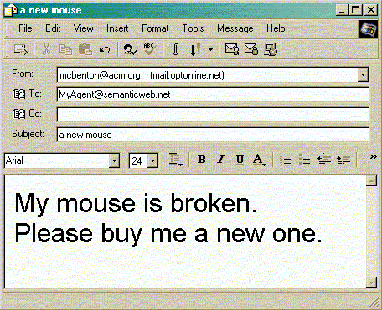
An Example
Use of ontology
“My mouse is broken” vs. “My mouse is dead”

Slide 37
Overview of Semantic Web
1st generation, Internet enabled machines to exchange data
2nd generation, enabled enormous amounts of information available, in human-readable form
The next generation of the net is an “agent-enabled” (Semantic Web) which makes information available in machine-readable form … enabling “agent” communication at a Web-wide scale
The Semantic Web is a vision: the idea of having data on the web defined and linked in a way that it can be used by machines

Slide 38
A Picture of Semantic Web
Web
use
User
Query
Service
Push
Push
Agent
Profile
Preference
Pull
Pull
Document
Agent view
Ontology view
Communication

Slide 39

Agents in Semantic Web
Software Agents can
- collect web content from diverse sources.
- process that information and exchange the results with
other programs(agents).
- also exchange “proofs” written in Semantic
Web’s “Unified Language”.
(UL : A language that expresses logical inferences made using rules and
information such as those specified by ontologies.)
Where is cook?
Online Services
Cook is in Missouri
Proof ?
Proof, doubts?
No

Slide 40
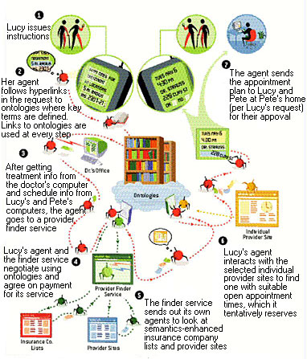
SOFTWARE AGENTS will be greatly facilitated by semantic content on the Web. In the depicted scenario, Lucy's agent tracks down a physical therapy clinic for her mother that meets a combination of criteria and has open appointment times that mesh with her and her brother Pete's schedules. Ontologies that define the meaning of semantic data play a key role in enabling the agent to understand what is on the Semantic Web, interact with sites and employ other automated services.

Slide 41
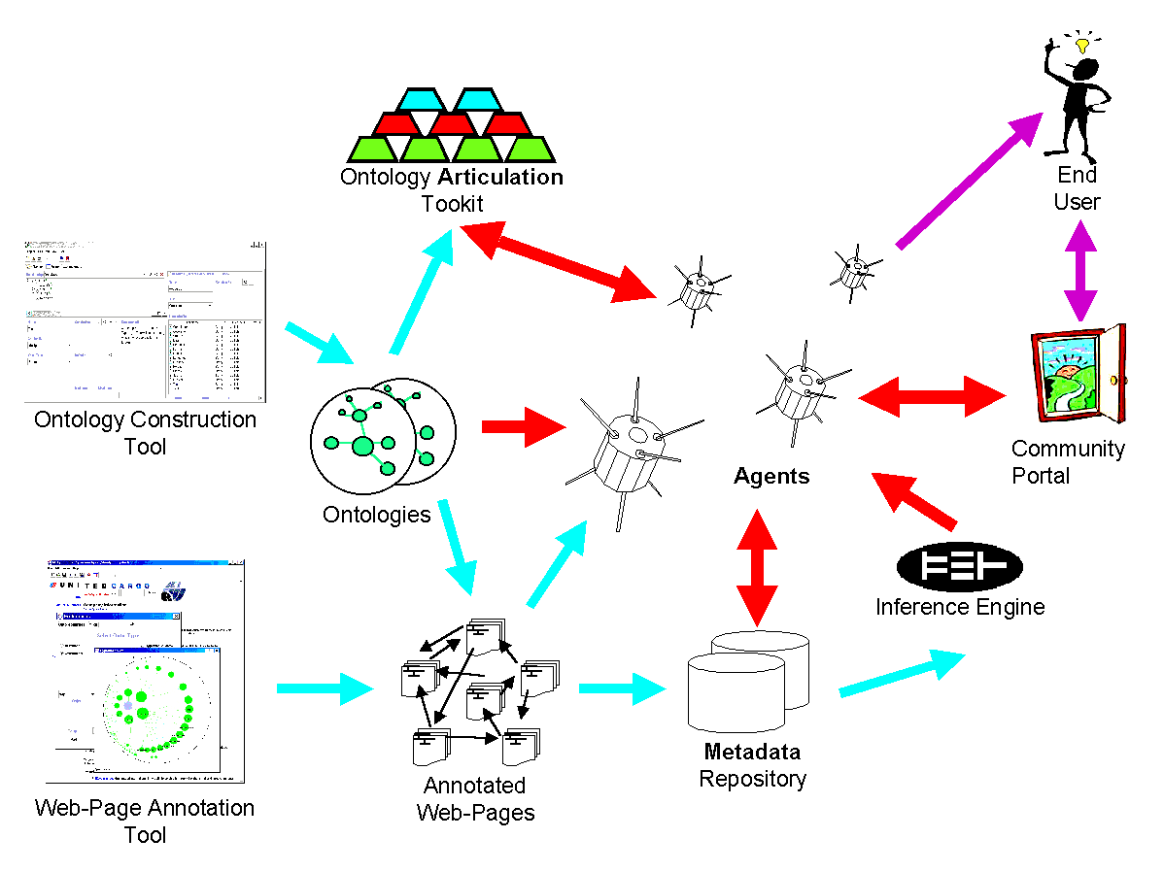
The Semantic Web

Slide 42
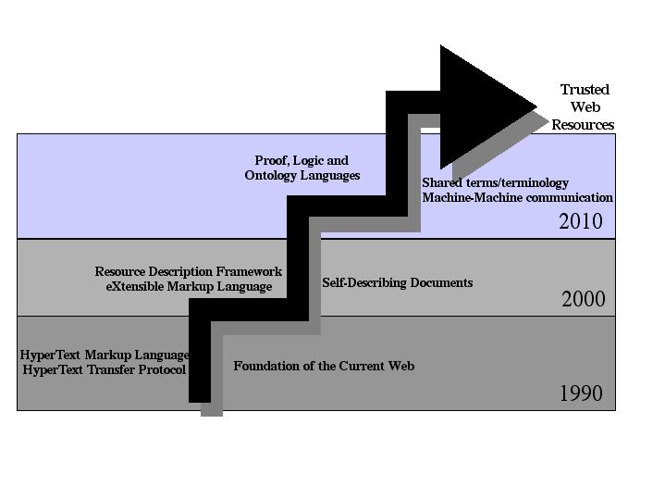
Evolution of Semantic Web

Slide 43
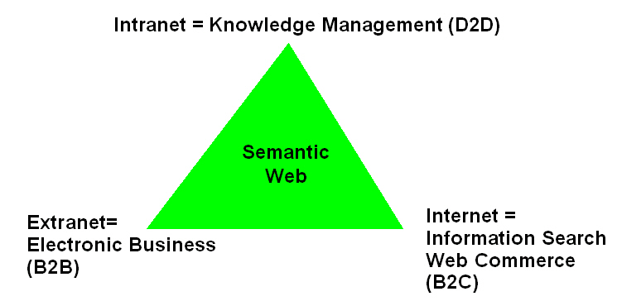
Applications: Knowledge Management and Electronic Commerce

Slide 44
Today
large number of on-line documents; document management systems have many weaknesses;
word matching as search method;
Information Retrieval instead of Query Answering;
document exchange between enterprises needs huge effort;
different views on documents are not supported.

Slide 45
Near Future
Ontologies will allow structural and semantic definitions of documents providing completely new possibilities;
Intelligent search instead of keyword matching;
Query Answering instead of Information Retrieval;
Document exchange between companies via transformation operators;
Definition of views on documents.

Slide 46
Web Commerce (B2C): The Near Future
Software agents understand the product information.
Meta-on-line shops can be build with small effort and enable complete market transparency.
The low-level programming of wrappers based on text extraction and format heuristics will become replaced by writing down ontology mappings, which translates different product descriptions into each other.
=> Intelligent agents are shopping on-line and select the best offer with the cheapest price.

Slide 47
Electronic Business (B2B): The Near Future
Ontology-based solutions for B2B have the following advantages:
  Understandability
  Integration in other document exchanges
  Maintenance is cheap
  Tool support
Two processes:
  Development of standard ontologies for product data exchange (shopping portals)
  Customer-specific ontologies and translation service.

Slide 48
Electronic Business (B2B): The Role of Ontologies
Commerce XML (cXML), www.oasis-open.org/cover/cxml.html, is a set of XML DTDs with their associated request/response processes.
Common Business Library (CBL) of Commerce Net, www.commerce.net, uses XML schemes.
RossettaNet, www.rossettanet.org, defines product catalogues for the PC industry.
Vertex: a web-based marketplace for life science products using a shared ontology.
=> XML standardizes the syntax but not modeling primitives, vocabulary, nor structure!

Slide 49
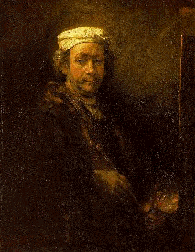
Why Semantics Matter

Slide 50
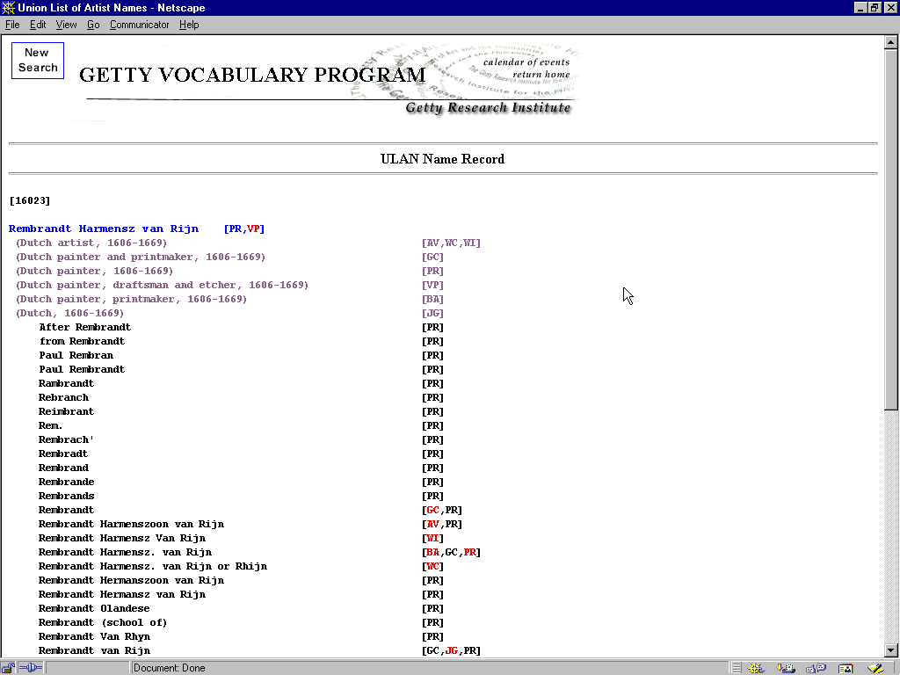
When you own a Rembrandt you can spell his name any way you want.

Slide 51
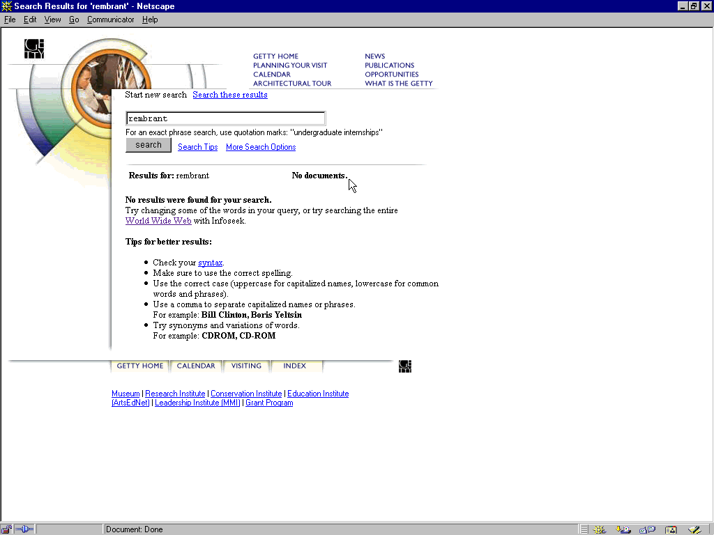
But when you want to find a Rembrandt … you better spell his name correctly.

Slide 52
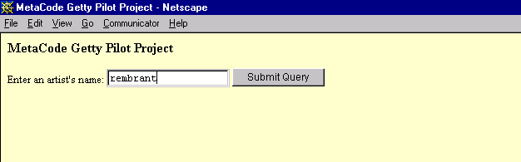
Vocabulary resources can help find the right artist even if their name is typed incorrectly.

Slide 53
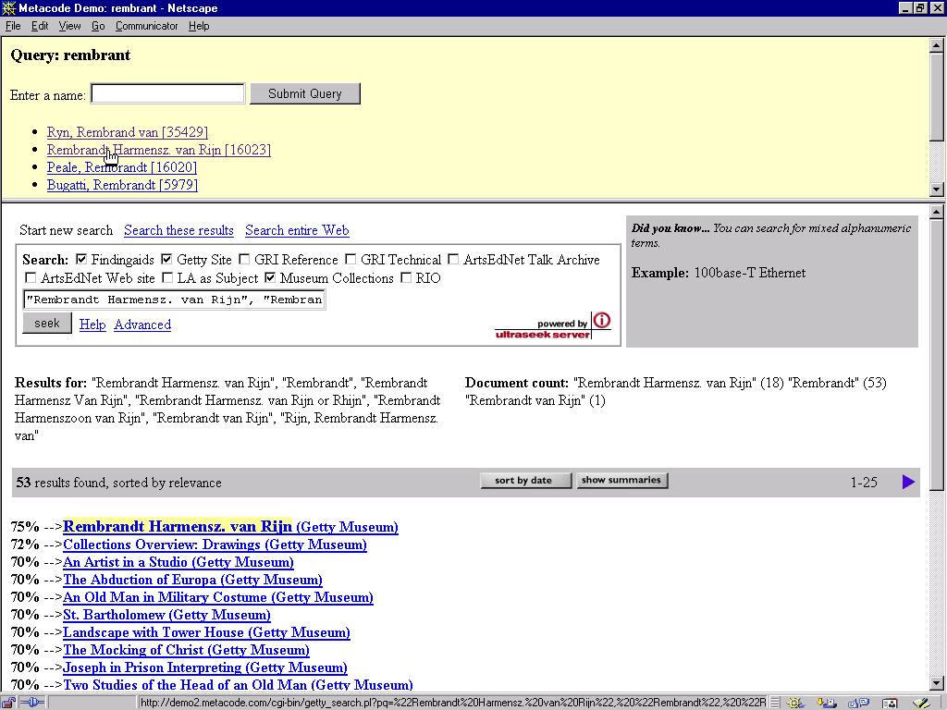
Users cannot type in the complex queries needed to find all the relevant items... But this can be done automatically.

Slide 54
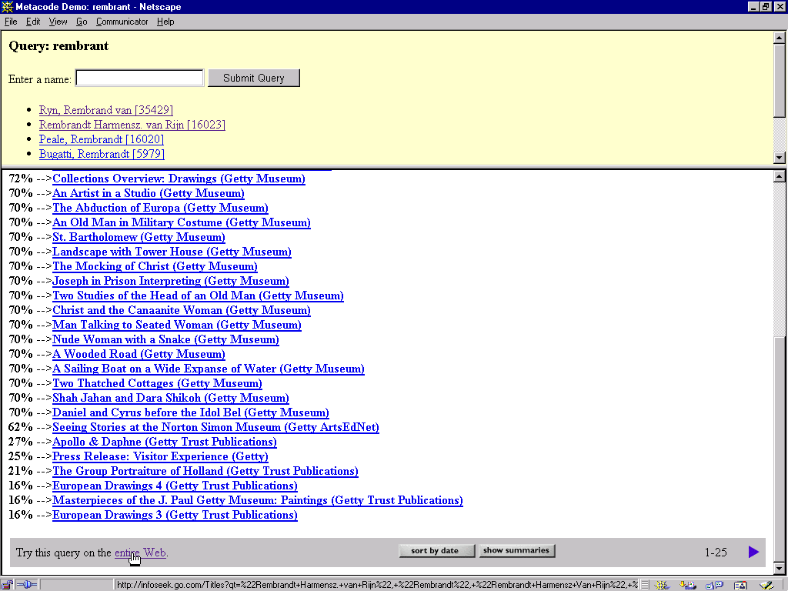
Complex queries are even more important when you search the entire web.

Slide 55
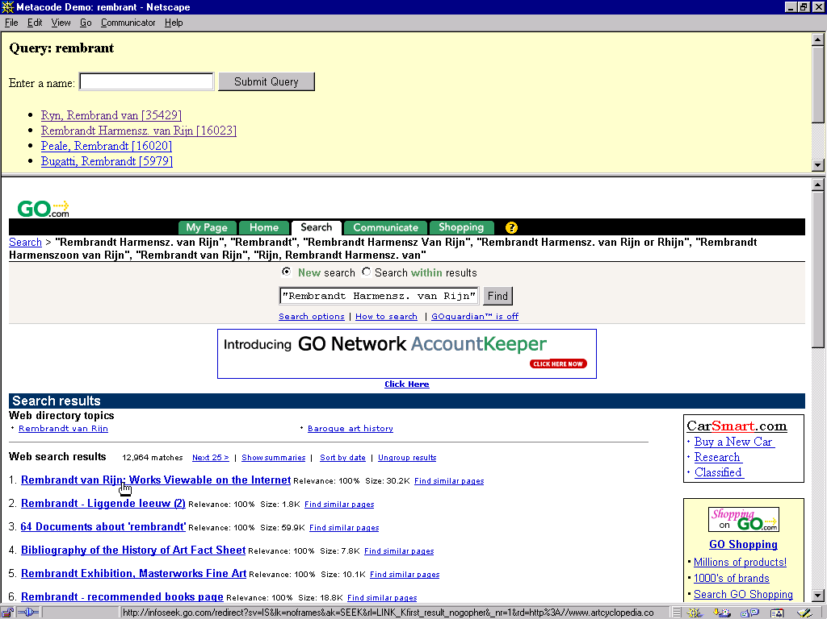
So you find Rembrandt the Dutch guy...

Slide 56
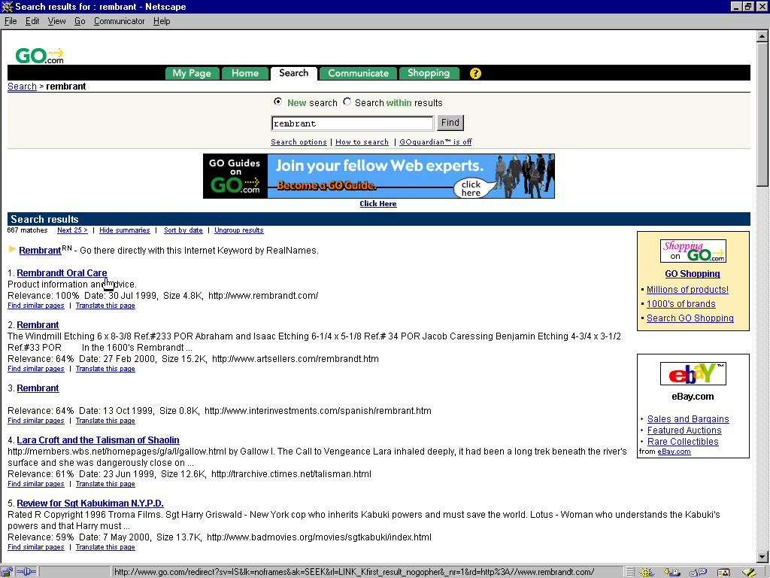
… And not Rembrandt the toothpaste.

Slide 57
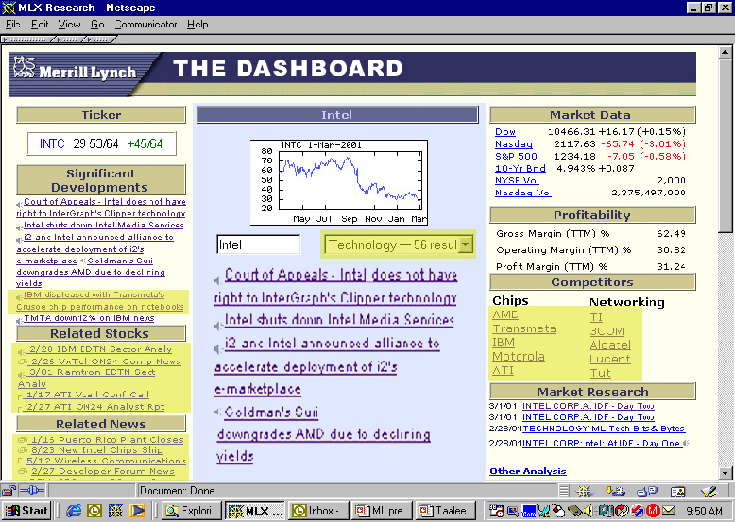
Semantic Web Application Example:
Financial Advisor Research Dashboard
Automatic Collation of semantically related digital media information from Multiple Sources
Research Inferred Automatically
Semantically Related News Not Specifically Asked For
Semantic Search/
Personalization, etc.

Slide 58
Semantic Web And Beyond…
Knowledge Discovery
Semantic Web
Information Integration

Slide 59
Relationships
Information
Integration
Simple
Relationships
+
=
Semantic Web
Complex
Relationships
Semantic Web
+
=
Knowledge Discovery

Slide 60
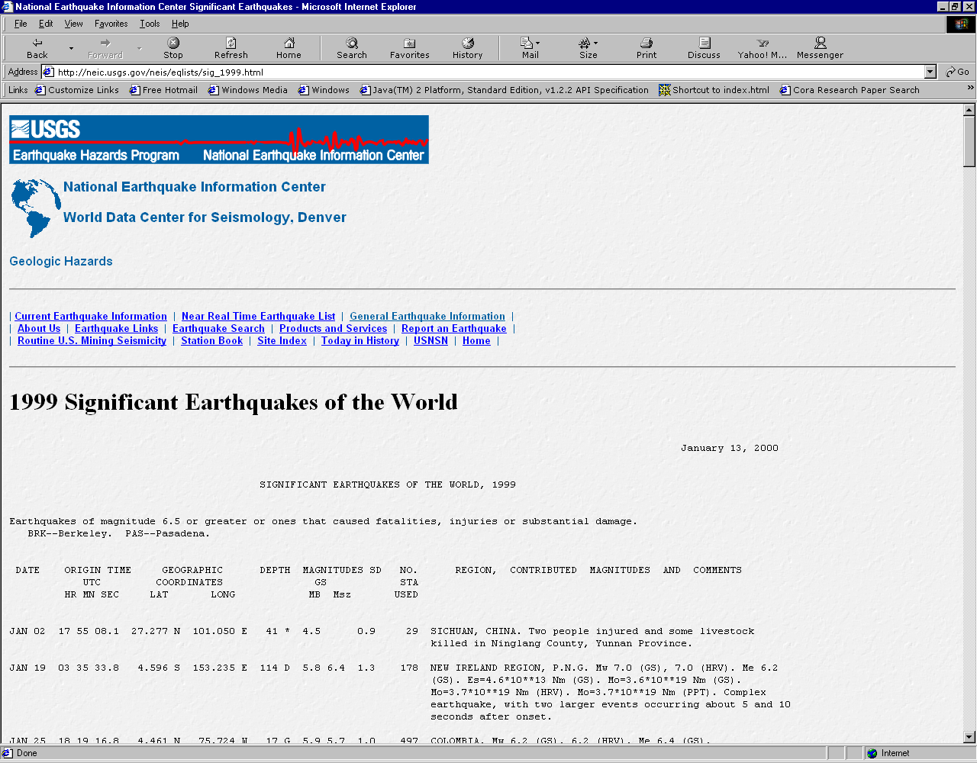
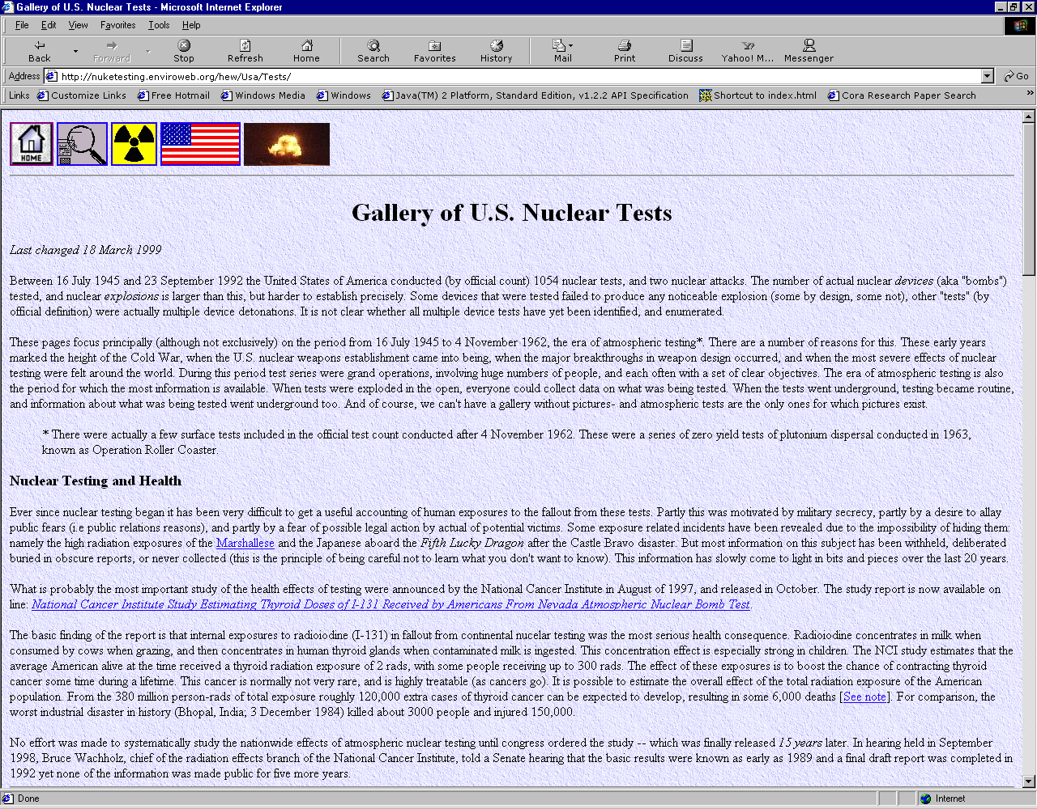
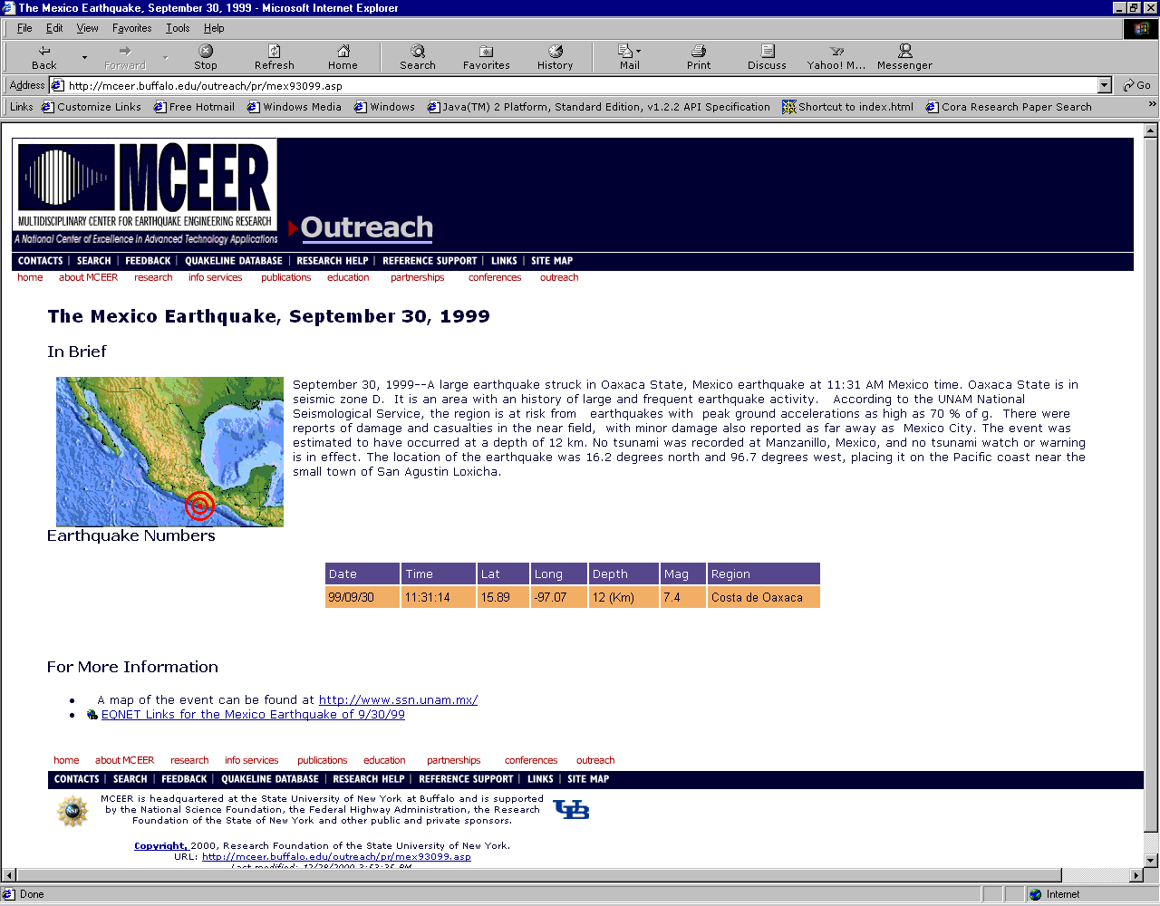
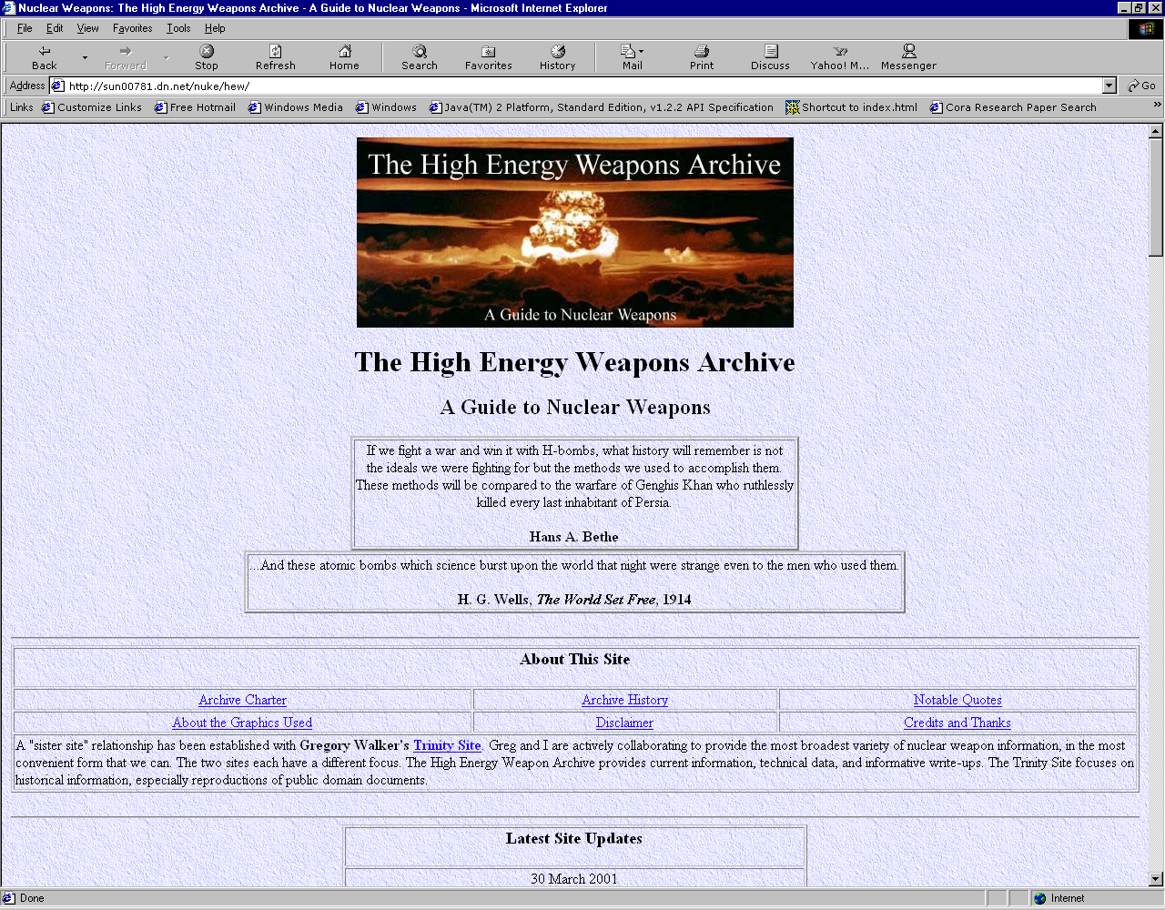
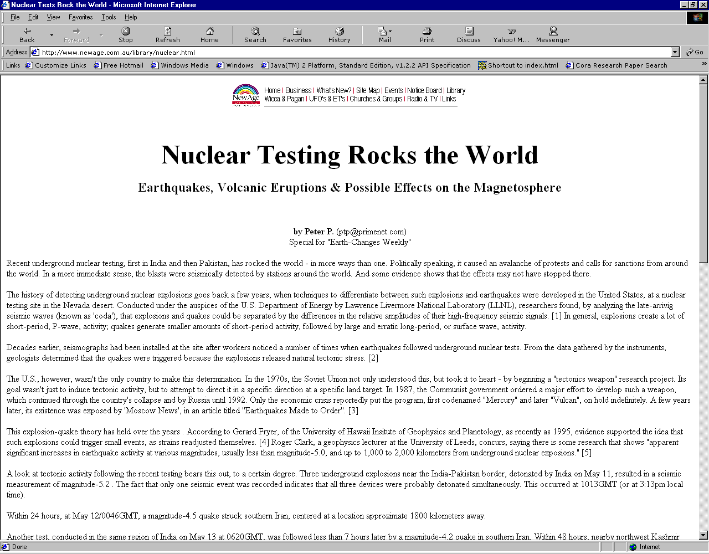
Knowledge Discovery - Example
Earthquake Sources
(USGS, NEIC)
Nuclear Test Sources
(Oklahoma Observatory, etc.)
Nuclear Test May Cause Earthquakes
Is it really true?

Slide 61
Complex Relationships
  A nuclear test could have caused an earthquake
  if the earthquake occurred some time after the
  nuclear test was conducted and in a nearby region.
  NuclearTest Causes Earthquake
  <= dateDifference( NuclearTest.eventDate,
  Earthquake.eventDate ) < 30
  AND distance( NuclearTest.latitude,
  NuclearTest.longitude,
  Earthquake,latitude,
  Earthquake.longitude ) < 10000

Slide 62
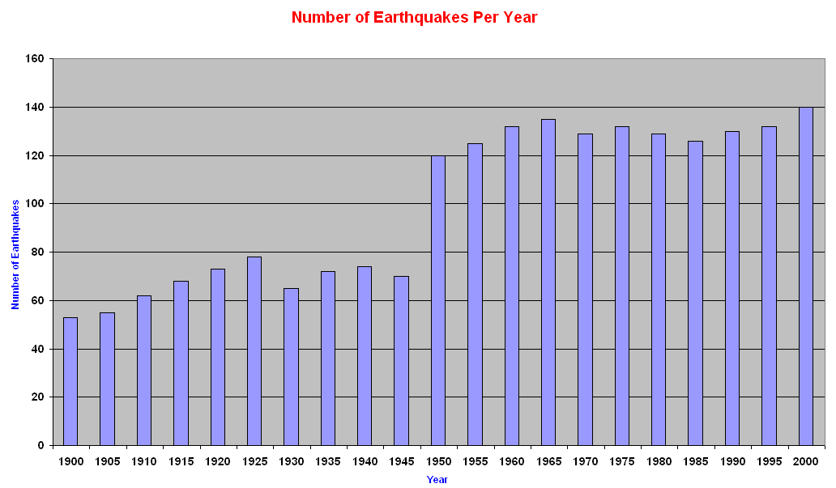
Knowledge Discovery - Example
When was the first recorded nuclear test conducted?
1950
Find the total number of earthquakes with a magnitude
5.8 or higher on the Richter scale per year starting from 1900
Increase in number of
earthquakes since 1945

Slide 63
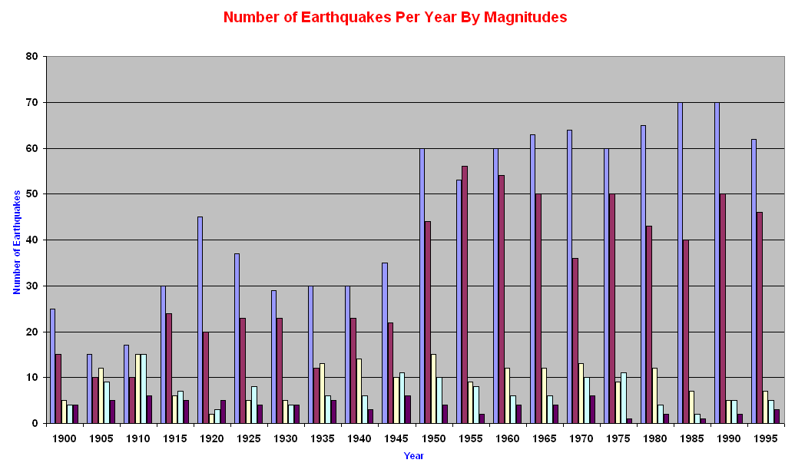
Knowledge Discovery - Example…
For each group of earthquakes with magnitudes in the ranges
5.8-6, 6-7, 7-8, 8-9, and >9 on the Richter scale per year
starting from 1900, find average number of earthquakes
Number of earthquakes with
magnitude > 7 almost constant.
So nuclear tests probably only
cause earthquakes with
magnitude < 7

Slide 64
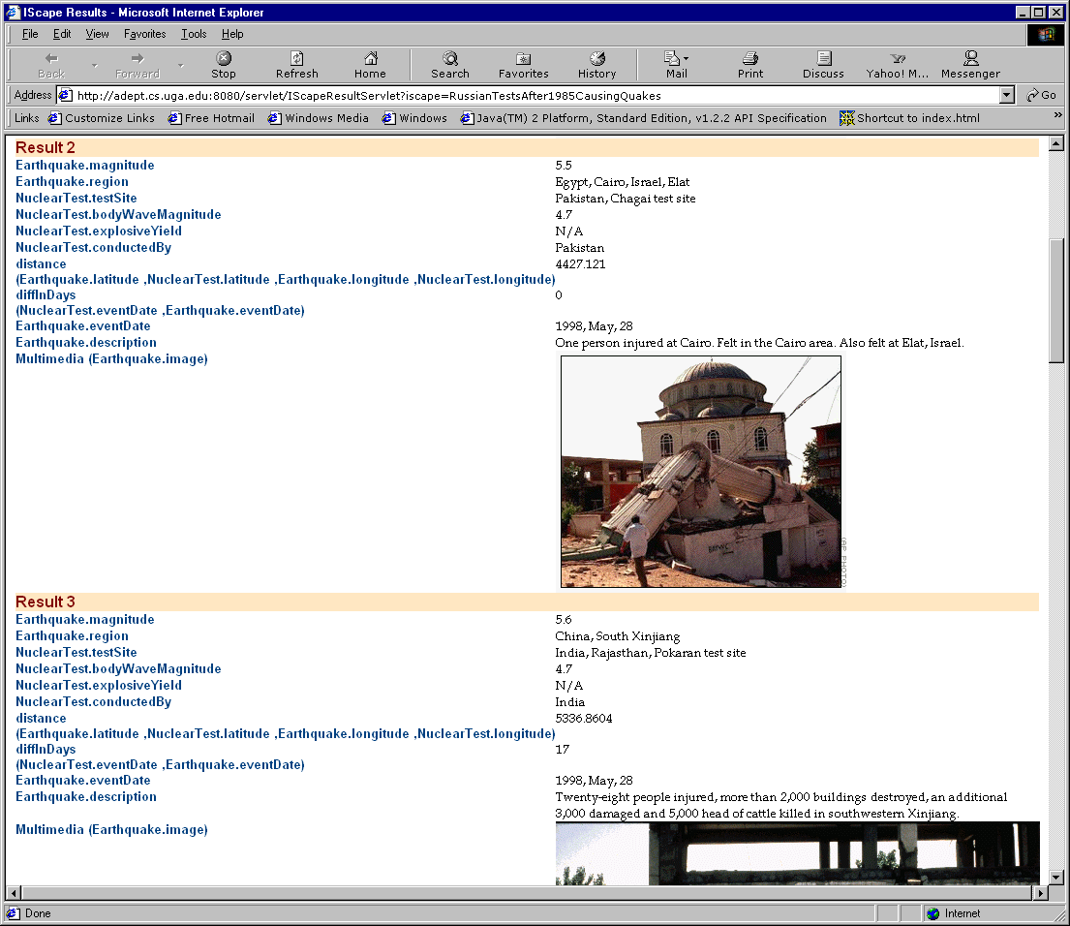
Knowledge Discovery - Example…
Find pairs of nuclear tests and earthquakes such that the earthquake
occurred within 30 days after the test was conducted and in a radius of
10000 miles from the epicenter of the earthquake

Slide 65
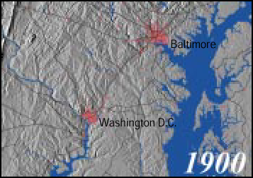
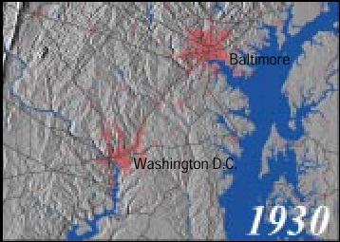
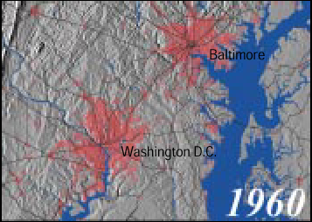
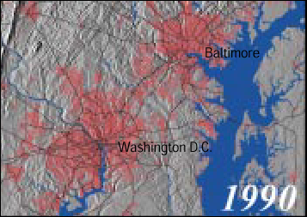
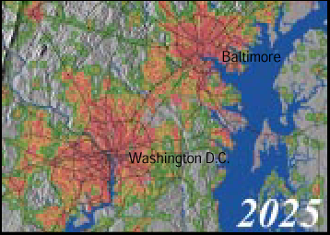
Simulations:
Clarke Urban Growth Model (UGM)
Source: http://edcdgs9.cr.usgs.gov/urban/factsht.pdf

Slide 66
Conclusions
The semantic web in naming every concept simply by a URI, lets everyone express new concepts that they invent with minimal effort.
Its unifying modeling language will enable these concepts to be progressively linked into a universal web.
The structure of semantic web will open up the knowledge and workings of human kind to meaningful analysis by software agents, providing a new class of tools by which we can live, work and learn together.

Slide 67
Conclusions
The semantic web will be based on machine-precessable semantics of data.
This will revolutionalize applications areas such as knowledge management and electronic commerce.
Means to achieve the full potential of the semantic web are languages (XML, RDF, OIL), Ontologies, and intelligent applications that make use of these means.
DARPA decited to spent 80 Million Dollar on funding research on the semantic web. The according projects have just started.
And Europe: Does it sleep again or did it received the wake-up call already?

Slide 68
Recommended Readings
http://www.scientificamerican.com/2001/0501issue/0501berners-lee.html
http://www.scientificamerican.com/1999/0599issue/0599bosak.html
http://www.w3.org/2001/sw/
http://www.ontoweb.org/
http://logicerror.com/semanticWeb-long
http://infomesh.net/2001/swintro/#whatIsSw

Slide 69
Summary:
Semantic Web Concept & Applications

Slide 70
Concept
500 million user
more than 3 billion pages
WWW
Static
URI, HTML, HTTP

Slide 71
Concept
Serious Problems in information
finding
extracting
representing
interpreting
and maintaining
WWW
Semantic Web
Static
URI, HTML, HTTP
RDF, RDF(S), OWL

Slide 72
Concept
Bringing the computer back as a device for computation
Web Services
Dynamic
UDDI, WSDL, SOAP
WWW
Semantic Web
Static
URI, HTML, HTTP
RDF, RDF(S), OWL

Slide 73
Concept
Bringing the web to its full potential
Web Services
Intelligent Web
Services
Dynamic
UDDI, WSDL, SOAP
WWW
Semantic Web
Static
URI, HTML, HTTP
RDF, RDF(S), OWL

Slide 74
Concept
The semantic web is based on machine-processable semantics of data.
Its backbone technology are Ontologies.
It is based on new web languages such as XML, RDF, and OWL, and tools that make use of these languages.

Slide 75
Concept
Ontologies are key enabling technology for the semantic web.
They interweave human understanding of symbols with their machine processability.
In a nutshell, Ontologies are formal and consensual specifications of conceptualizations that provide a shared and common understanding of a domain.

Slide 76
Applications
Knowledge Management
Enterprise Application Integration
eCommerce

Slide 77
Knowledge Management
The competitiveness of companies in quickly changing markets depends heavily on how they exploit and maintain their knowledge.
Increasingly, companies realize that their intranets are valuable repositories of corporate knowledge.
To deal with this, several document management systems entered the market. However, these systems have severe weaknesses.

Slide 78
Knowledge Management
Searching information: Existing keyword-based search retrieves irrelevant information that uses a certain term in a different meaning, and misses information when different terms with the same meaning about the desired content are used.
Extracting information: Currently, human browsing and reading is required to extract relevant information from information sources and they need to manually integrate information spread over different sources.

Slide 79
Knowledge Management
Maintaining weakly structured text sources is a difficult and time-consuming activity when such sources become large. Keeping such collections consistent, correct, and up-to-date requires mechanized representations of semantics that help to detect anomalies.
Automatic document generation would enable adaptive websites that are dynamically reconfigured according to user profiles or other aspects of relevance.

Slide 80
Knowledge Management
The Semantic Web will provide much more automated services based on machine-processable semantics of data, and on heuristics that make use of these metadata.
Currently, we see many projects and products that are close to the market employing such concepts and ideas.

Slide 81
Enterprise Application Integration
The integration of data, information, knowledge; processes; applications; and business becomes more and more important.
Therefore, the Enterprise Application Integration area will have soon a major share of the overall spent IT expenses.
A number of reasons are responsible for this trend.

Slide 82
Enterprise Application Integration
Up to now, many companies trying to solve their integration needs by adhoc integration projects, however, adhoc integration do not scale.
Therefore, after a phase of adhoc integration companies start to search for the Silver bullet that may help to solve the growing problem.
However, global integration requires serious investments and time.

Slide 83
Enterprise Application Integration
A successful integration strategy must combine the advantages of adhoc and global integration strategies:
  Learning from adhoc integration means to make sure that we must reflect business needs as the driving force for the integration process;
  Learning from global integration means to make sure that we must create extendable and reusable integrations.

Slide 84
Enterprise Application Integration
    Purpose-driven. We need to identify the major integration needs in terms of business processes and to structure our integration efforts around these needs.
    Extendable. We use Ontologies for publishing the information of data sources and for aligning it with business needs. By using Ontologies for making information explicit we ensure that our integration efforts can be extended in response to new and changed business needs.
    Reusable: Use web service technology to reflect further integration needs based on standardization. Web services as a vendor and platform independent software integration platform are of critical importance.

Slide 85
Enterprise Application Integration
We expect that Enterprise Application Integration will be the major application are of Semantic Web technology before it will take the next logical step:
=> the integration of several organizations, i.e., eCommerce.

Slide 86
eCommerce
eCommerce in business to business (B2B) is not a new phenomenon.
However, the automatization of business transactions has not lived up to the expectations of its propagandists.
Establishing a eCommerce relationship requires a serious investment and it its limited to a predefined number of trading partners.

Slide 87
eCommerce
Internet-based electronic commerce provides a much higher level of openness, flexibility and dynamics that will help to optimize business relationships.
Anytime, anywhere, and anybody eCommerce provides completely new possibilities.

Slide 88
eCommerce
Instead of implementing one link to each supplier, a supplier is linked to a large number of potential customers when he is connected to the marketplace.
A supplier or customer can change its business relationships reflecting new demands from his market.
This enables virtual enterprises and vica versa it enables to brake large enterprises up into smaller pieces that mediate their eWork relationship based on eCommerce relationships.

Slide 89
eCommerce
However, enabling flexible and open eCommerce has to deal with serious problems.
Heterogeneity in the product, catalogue, and document description standards of the trading partner.
Effective and efficient management of different styles of description becomes a key obstacle for this approach.

Slide 90
eCommerce: Openess
Openness of eCommerce cannot be achieved without standardization.
This we can learn from the web!
Here, we also require standardization of the actual content, i.e., we require Ontologies.

Slide 91
eCommerce: Flexibility
Flexibility of eCommerce cannot be achieved without multi-standard approaches.
Ontology need to be implemented as networks of meaning where from the very beginning, heterogeneity is an essential requirement for this Ontology network.
Tools for dealing with conflicting definitions and strong support in interweaving local theories are essential in order to make this technology workable and scalable.

Slide 92
eCommerce: Dynamic
Dynamic of eCommerce requires standards that act as living entities.
Products, services, and trading modes are subject of high change rates.
Ontologies are used as a means of exchanging meaning between different agents.
They can only provide this if they reflect an inter-subjectual consensus.
By definition, they can only be the result of a social process.

Slide 93
eCommerce: Dynamic
  For this reason, Ontologies cannot be understood as a static model.
  An Ontology is as much required for the exchange of meaning as the exchange of meaning may influence and modify an Ontology.
  Consequently, evolving Ontologies describe a process rather than a static model.
  Ontologies must have strong support in versioning and must be accompanied by process models that help to organize evolving consensus.

Slide 94
Summary: Research versus Impact Tradeoff
eCommerce
Impact
Enterprise Application Integration
Knowledge Management
Risc

Slide 95
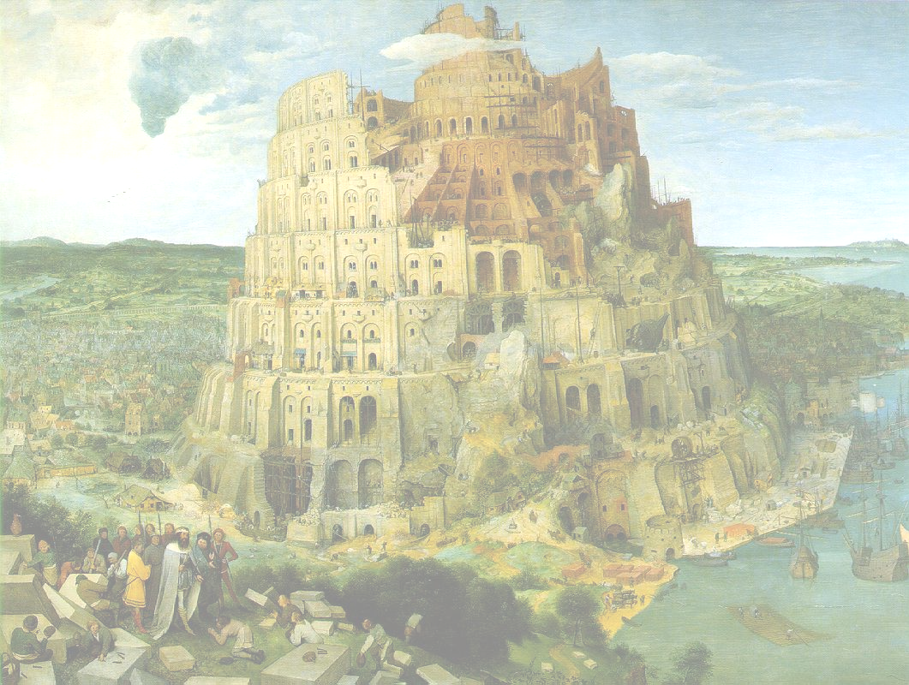
Heterogeneity...
… is a Babel Tower!!
SEMANTIC HETEROGENEITY
metadata
ontologies
contexts
SEMANTIC INTEROPERABILITY

